Slide 1
INFO 341 Routing Revisited
By
Bob Larson

Slide 2
Topics
How many networks here?
An IP Addressing Scheme
Packet Tracer Implementation
Types of IGPs
Routing Information Protocol (RIP)
Open Shortest Path First (OSPF)

Slide 3
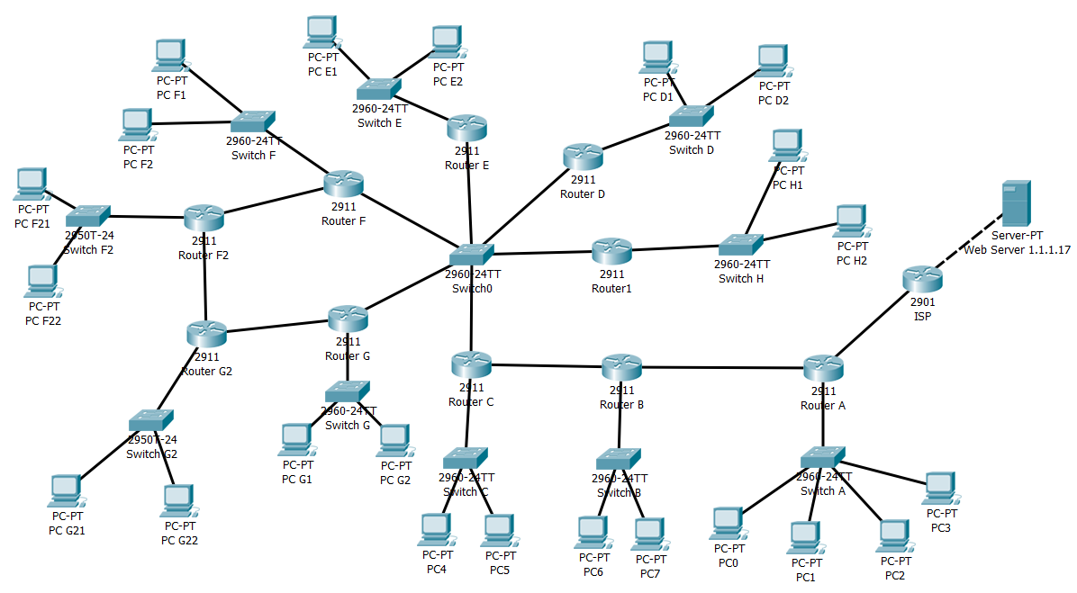
How many networks here?
14
15
13
12
11
17
16
10
9
1
5
3
7
8
6
4
2

Slide 4
An IP Addressing Scheme
10.0.16.0/21
10.0.24.0/24
10.0.12.0/22
.20
.19
10.0.0.32/30
.21
10.0.25.0/24
.33
10.0.8.0/22
10.0.0.16/28
.18
10.0.0.12/30
H
.13
10.0.0.8/30
.22
.9
.17
10.0.0.4/30
10.0.0.0/30
.5
.1
10.0.3.0/24
10.0.2.0/24
10.0.1.0/24
10.0.4.0/23
10.0.6.0/23

Slide 5
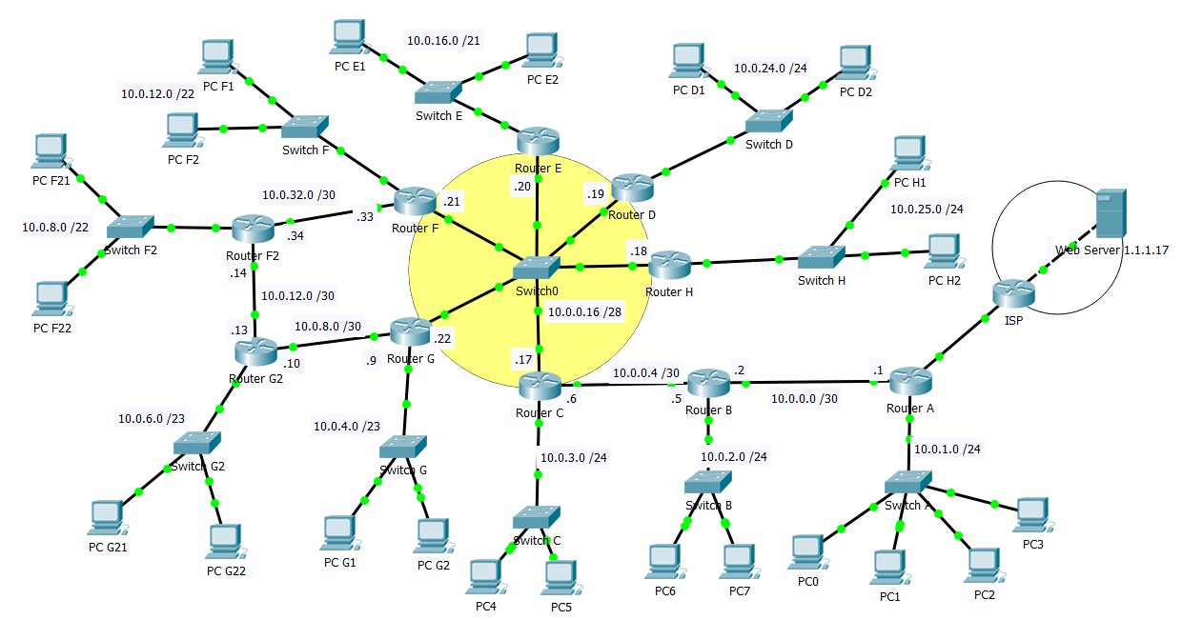
Packet Tracer Implementation
Class6-1-No Routing
Class6-2-RIP Routing
Class6-3-OSP Routing

Slide 6
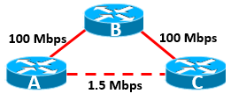
Types of IGPs
Distance Vector Protocols (example RIP)
Original, older, routing protocols
Measured distance in hop counts (metric)
How many routers to the destination
Smaller the hop count always chosen (A>C over A>B>C)
Ignored link speed (bandwidth)
Link State Protocols (example OSPF)
Uses metrics that factor in bandwidth
Smallest metric chosen, fastest route (A>B>C over A>C)
Less likely to pick a sub-optimal route
Converges faster than DV after network changes
All routers agree on changes and ready to forward data

Slide 7
Routing Information Protocol (RIP)
Sends the entire contents of its routing table
Out each interface every 30 seconds with Time to Live (TTL) of 1
RIPv1
Uses a broadcast – disturbs all devices even on LAN
Sends the route and hop count
RIPv2
Uses a multicast – only processed by routers. PCs ignore.
Sends route, subnet mask, and default gateway
Authentication is used for security
Route is
Flagged as unreachable by the receiving routers after 180 seconds
Removed from their tables after an additional 120 seconds.

Slide 8
Router B’s Route Table
10.0.0.0/8 is variably subnetted, 19 subnets, 7 masks
C 10.0.0.0/30 is directly connected, GigabitEthernet0/2
L 10.0.0.2/32 is directly connected, GigabitEthernet0/2
C 10.0.0.4/30 is directly connected, GigabitEthernet0/0
L 10.0.0.5/32 is directly connected, GigabitEthernet0/0
R 10.0.0.8/30 [120/2] via 10.0.0.6, 00:00:19, GigabitEthernet0/0
R 10.0.0.12/30 [120/3] via 10.0.0.6, 00:00:19, GigabitEthernet0/0
R 10.0.0.16/28 [120/1] via 10.0.0.6, 00:00:19, GigabitEthernet0/0
R 10.0.0.32/30 [120/2] via 10.0.0.6, 00:00:19, GigabitEthernet0/0
R 10.0.1.0/24 [120/1] via 10.0.0.1, 00:00:12, GigabitEthernet0/2
C 10.0.2.0/24 is directly connected, GigabitEthernet0/1
L 10.0.2.1/32 is directly connected, GigabitEthernet0/1
R 10.0.3.0/24 [120/1] via 10.0.0.6, 00:00:19, GigabitEthernet0/0
R 10.0.4.0/23 [120/2] via 10.0.0.6, 00:00:19, GigabitEthernet0/0
R 10.0.6.0/23 [120/3] via 10.0.0.6, 00:00:19, GigabitEthernet0/0
R 10.0.8.0/22 [120/3] via 10.0.0.6, 00:00:19, GigabitEthernet0/0
R 10.0.12.0/22 [120/2] via 10.0.0.6, 00:00:19, GigabitEthernet0/0
R 10.0.16.0/21 [120/2] via 10.0.0.6, 00:00:19, GigabitEthernet0/0
R 10.0.24.0/24 [120/2] via 10.0.0.6, 00:00:19, GigabitEthernet0/0
R 10.0.25.0/24 [120/2] via 10.0.0.6, 00:00:19, GigabitEthernet0/0
R* 0.0.0.0/0 [120/1] via 10.0.0.1, 00:00:12, GigabitEthernet0/2 RouterB#
Hop Count
Who it heard it from
How long since update (over 30 means missed update)
Interface to reach
RIP
Learned from Router A
All other routers learned from Router C or directly connected.
Learned from Router A

Slide 9
Router A’s Route Table
10.0.0.0/8 is variably subnetted, 19 subnets, 7 masks
C 10.0.0.0/30 is directly connected, GigabitEthernet0/2
L 10.0.0.2/32 is directly connected, GigabitEthernet0/2
C 10.0.0.4/30 is directly connected, GigabitEthernet0/0
L 10.0.0.5/32 is directly connected, GigabitEthernet0/0
R 10.0.0.8/30 [120/2] via 10.0.0.6, 00:00:19, GigabitEthernet0/0
R 10.0.0.12/30 [120/3] via 10.0.0.6, 00:00:19, GigabitEthernet0/0
R 10.0.0.16/28 [120/1] via 10.0.0.6, 00:00:19, GigabitEthernet0/0
R 10.0.0.32/30 [120/2] via 10.0.0.6, 00:00:19, GigabitEthernet0/0
R 10.0.1.0/24 [120/1] via 10.0.0.1, 00:00:12, GigabitEthernet0/2
C 10.0.2.0/24 is directly connected, GigabitEthernet0/1
L 10.0.2.1/32 is directly connected, GigabitEthernet0/1
R 10.0.3.0/24 [120/1] via 10.0.0.6, 00:00:19, GigabitEthernet0/0
R 10.0.4.0/23 [120/2] via 10.0.0.6, 00:00:19, GigabitEthernet0/0
R 10.0.6.0/23 [120/3] via 10.0.0.6, 00:00:19, GigabitEthernet0/0
R 10.0.8.0/22 [120/3] via 10.0.0.6, 00:00:19, GigabitEthernet0/0
R 10.0.12.0/22 [120/2] via 10.0.0.6, 00:00:19, GigabitEthernet0/0
R 10.0.16.0/21 [120/2] via 10.0.0.6, 00:00:19, GigabitEthernet0/0
R 10.0.24.0/24 [120/2] via 10.0.0.6, 00:00:19, GigabitEthernet0/0
R 10.0.25.0/24 [120/2] via 10.0.0.6, 00:00:19, GigabitEthernet0/0
R* 0.0.0.0/0 [120/1] via 10.0.0.1, 00:00:12, GigabitEthernet0/2
RouterB#
All learned from Router B or directly connected

Slide 10
Router C’s Route Table
Six updates every 30 seconds
10.0.0.0/8 is variably subnetted, 19 subnets, 7 masks
R 10.0.0.0/30 [120/1] via 10.0.0.5, 00:00:03, GigabitEthernet0/0
C 10.0.0.4/30 is directly connected, GigabitEthernet0/0
L 10.0.0.6/32 is directly connected, GigabitEthernet0/0
R 10.0.0.8/30 [120/1] via 10.0.0.22, 00:00:25, GigabitEthernet0/2
R 10.0.0.12/30 [120/2] via 10.0.0.21, 00:00:17, GigabitEthernet0/2
[120/2] via 10.0.0.22, 00:00:25, GigabitEthernet0/2
C 10.0.0.16/28 is directly connected, GigabitEthernet0/2
L 10.0.0.17/32 is directly connected, GigabitEthernet0/2
R 10.0.0.32/30 [120/1] via 10.0.0.21, 00:00:17, GigabitEthernet0/2
R 10.0.1.0/24 [120/2] via 10.0.0.5, 00:00:03, GigabitEthernet0/0
R 10.0.2.0/24 [120/1] via 10.0.0.5, 00:00:03, GigabitEthernet0/0
C 10.0.3.0/24 is directly connected, GigabitEthernet0/1
L 10.0.3.1/32 is directly connected, GigabitEthernet0/1
R 10.0.4.0/23 [120/1] via 10.0.0.22, 00:00:25, GigabitEthernet0/2
R 10.0.6.0/23 [120/2] via 10.0.0.22, 00:00:25, GigabitEthernet0/2
R 10.0.8.0/22 [120/2] via 10.0.0.21, 00:00:17, GigabitEthernet0/2
R 10.0.12.0/22 [120/1] via 10.0.0.21, 00:00:17, GigabitEthernet0/2
R 10.0.16.0/21 [120/1] via 10.0.0.20, 00:00:20, GigabitEthernet0/2
R 10.0.24.0/24 [120/1] via 10.0.0.19, 00:00:10, GigabitEthernet0/2
R 10.0.25.0/24 [120/1] via 10.0.0.18, 00:00:21, GigabitEthernet0/2
R* 0.0.0.0/0 [120/2] via 10.0.0.5, 00:00:03, GigabitEthernet0/0
RouterC#
Router B
Router F
Router G
Router E
Router D
Router H

Slide 11
Open Shortest Path First (OSPF)
Sends status of only its own links (interfaces)
Immediately when detects a change (no waiting for timer)
Uses multicasts to inform all other OSPF routers
Ignored by PCs
Instead of hops, uses metric (cost) based on bandwidth
Each router uses algorithm to calculate best routes
Offers router authenication

Slide 12
Router A’s Route Table
Next Hop
1.0.0.0/8 is variably subnetted, 2 subnets, 2 masks
C 1.2.2.0/30 is directly connected, GigabitEthernet0/0
L 1.2.2.2/32 is directly connected, GigabitEthernet0/0
10.0.0.0/8 is variably subnetted, 18 subnets, 7 masks
C 10.0.0.0/30 is directly connected, GigabitEthernet0/2
L 10.0.0.1/32 is directly connected, GigabitEthernet0/2
O 10.0.0.4/30 [110/2] via 10.0.0.2, 00:20:01, GigabitEthernet0/2
O 10.0.0.8/30 [110/4] via 10.0.0.2, 00:19:51, GigabitEthernet0/2
O 10.0.0.12/30 [110/5] via 10.0.0.2, 00:19:51, GigabitEthernet0/2
O 10.0.0.16/28 [110/3] via 10.0.0.2, 00:20:01, GigabitEthernet0/2
O 10.0.0.32/30 [110/4] via 10.0.0.2, 00:19:51, GigabitEthernet0/2
C 10.0.1.0/24 is directly connected, GigabitEthernet0/1
L 10.0.1.1/32 is directly connected, GigabitEthernet0/1
O 10.0.2.0/24 [110/2] via 10.0.0.2, 00:20:01, GigabitEthernet0/2
O 10.0.3.0/24 [110/3] via 10.0.0.2, 00:20:01, GigabitEthernet0/2
O 10.0.4.0/23 [110/4] via 10.0.0.2, 00:19:51, GigabitEthernet0/2
O 10.0.6.0/23 [110/5] via 10.0.0.2, 00:19:51, GigabitEthernet0/2
O 10.0.8.0/22 [110/5] via 10.0.0.2, 00:19:51, GigabitEthernet0/2
O 10.0.12.0/22 [110/4] via 10.0.0.2, 00:19:51, GigabitEthernet0/2
O 10.0.16.0/21 [110/4] via 10.0.0.2, 00:19:51, GigabitEthernet0/2
O 10.0.24.0/24 [110/4] via 10.0.0.2, 00:19:51, GigabitEthernet0/2
O 10.0.25.0/24 [110/4] via 10.0.0.2, 00:20:01, GigabitEthernet0/2
S* 0.0.0.0/0 [1/0] via 1.2.2.1
RouterA#
How long since last update (Longer is better – stable)
Interface to use
OSPF

Slide 13
Router C’s Route Table
10.0.0.0/8 is variably subnetted, 19 subnets, 7 masks
O 10.0.0.0/30 [110/2] via 10.0.0.5, 00:29:52, GigabitEthernet0/0
C 10.0.0.4/30 is directly connected, GigabitEthernet0/0
L 10.0.0.6/32 is directly connected, GigabitEthernet0/0
O 10.0.0.8/30 [110/2] via 10.0.0.22, 00:29:42, GigabitEthernet0/2
O 10.0.0.12/30 [110/3] via 10.0.0.21, 00:29:42, GigabitEthernet0/2
[110/3] via 10.0.0.22, 00:29:42, GigabitEthernet0/2
C 10.0.0.16/28 is directly connected, GigabitEthernet0/2
L 10.0.0.17/32 is directly connected, GigabitEthernet0/2
O 10.0.0.32/30 [110/2] via 10.0.0.21, 00:29:42, GigabitEthernet0/2
O 10.0.1.0/24 [110/3] via 10.0.0.5, 00:29:52, GigabitEthernet0/0
O 10.0.2.0/24 [110/2] via 10.0.0.5, 00:29:52, GigabitEthernet0/0
C 10.0.3.0/24 is directly connected, GigabitEthernet0/1
L 10.0.3.1/32 is directly connected, GigabitEthernet0/1
O 10.0.4.0/23 [110/2] via 10.0.0.22, 00:29:42, GigabitEthernet0/2
O 10.0.6.0/23 [110/3] via 10.0.0.22, 00:29:42, GigabitEthernet0/2
O 10.0.8.0/22 [110/3] via 10.0.0.21, 00:29:42, GigabitEthernet0/2
O 10.0.12.0/22 [110/2] via 10.0.0.21, 00:29:42, GigabitEthernet0/2
O 10.0.16.0/21 [110/2] via 10.0.0.20, 00:29:42, GigabitEthernet0/2
O 10.0.24.0/24 [110/2] via 10.0.0.19, 00:29:52, GigabitEthernet0/2
O 10.0.25.0/24 [110/2] via 10.0.0.18, 00:29:52, GigabitEthernet0/2
O*E2 0.0.0.0/0 [110/1] via 10.0.0.5, 00:29:52, GigabitEthernet0/0
RouterC#
Both included only because they have the same metric
Still lots of next Hops but no updates in 30 minutes

Slide 14
Fin…

